Slide 1
Counting

Slide 2
Why?
To solve different types of problem
Counting is used to determine the complexity of algorithms.
Counting is also required to determine whether there are enough telephone numbers or Internet protocol addresses to meet demand.
Furthermore, counting techniques are used extensively when probabilities of events are computed.

Slide 3
Basic Counting Principles: THE PRODUCT RULE
The Product Rule
Suppose that a procedure can be broken down into a sequence of two tasks. If there are n₁ ways to do the first task and for each of these ways of doing the first task, there are n₂ ways to do the second task, then there are n₁.n₂ ways to do the procedure.

Slide 4
The Product Rule : Example
Problem : How many different license plates can be made if each plate contains a sequence of three uppercase English letters followed by three digits (and no sequences of letters are prohibited)?
Solution: There are 26 choices for each of the three uppercase English letters and ten choices for each of the three digits. Hence, by the product rule there are a total of 26·26·26·10·10·10 = 17,576,000 possible license plates.

Slide 5
The Product Rule : Example
Problem : Suppose a college has 3 different history courses, 4 different literature courses, and 2 different sociology courses. What is the number of ways a student can choose just one of each kind of courses?
Solution: 3 · 4 · 2 = 24 possible ways

Slide 6
The Product Rule : Example
Problem : There are 32 microcomputers in a computer center. Each microcomputer has 24 ports. How many different ports to a microcomputer in the center are there?
Solution: The procedure of choosing a port consists of two tasks, first picking a microcomputer and then picking a port on this microcomputer. Because there are 32 ways to choose the microcomputer and 24 ways to choose the port no matter which microcomputer has been selected, the product rule shows that there are
32·24=768 ports.

Slide 7
The Product Rule : Example
Problem : A new company with just two employees, Anik and Arafat, rents a floor of a building with 12 offices. How many ways are there to assign different offices to these two employees?
Solution: The procedure of assigning offices to these two employees consists of assigning an office to Anik, which can be done in 12 ways, then assigning an office to Arafat different from the office assigned to Anik, which can be done in 11 ways. By the product rule, there are 12·11 = 132 ways to assign offices to these two employees.

Slide 8
The Product Rule : Example
Problem : How many different bit strings of length seven are there?
Solution: Each of the seven bits can be chosen in two ways, because each bit is either 0 or 1. Therefore, the product rule shows there are a total of 2^7=128 different bit strings of length seven.

Slide 9
Basic Counting Principles: THE SUM RULE
The Sum Rule
If a task can be done either in one of n₁ ways or in one of n₂ ways, where none of the set of n₁ ways is the same as any of the set of n₂ ways, then there are n₁ ₊ n₂ ways to do the task.

Slide 10
The Sum Rule : Example
Problem : A student can choose a computer project from one of three lists. The three lists contain 23, 15, and 19 possible projects, respectively. No project is on more than one list. How many possible projects are there to choose from?
Solution: The student can choose a project by selecting a project from the first list, the second list, or the third list. Because no project is on more than one list, by the sum rule there are 23+15+19=57 ways to choose a project.

Slide 11
The Sum Rule : Example
Problem : Suppose a college has 3 different history courses, 4 different literature courses, and 2 different sociology courses. What is the number of ways a student can choose just one of the courses?
Solution: 3 + 4 + 2 = 9

Slide 12
Basic Counting Principles
Key Difference:
Sum rule applies when events are mutually exclusive (either one task or another can happen, not both).
Product rule applies when events are independent (you perform both tasks in sequence, with each choice being independent of the other).

Slide 13
The Sum Rule Vs. Product Rule
Problem : Fatema wants to go to Chattogram. She can choose from 3 bus services or 2 train services to head from Rajshahi to downtown Dhaka. From there, she can choose from 2 bus services or 3 train services to head to Chattogram. How many ways are there for Fatema to get to Chattogram?
Solution: She has 3 + 2= 5 ways to get to downtown Dhaka . (Rule of sum) From there, She has 2+3=5 ways to get to Chattogram. (Rule of sum) Hence, she has 5×5=25 ways to get to Chattogram in total. (Rule of product)

Slide 14
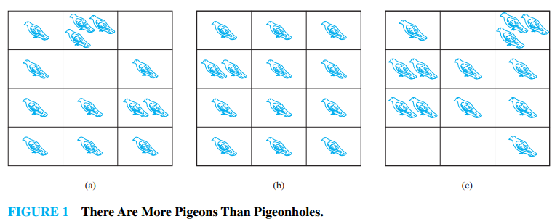
The Pigeonhole Principle
The principle proves the existence (or impossibility) of a particular phenomenon

Slide 15
The Pigeonhole Principle
Theorem
If k is a positive integer and k+1 or more objects are placed into k boxes, then there is at least one box containing two or more of the objects.

Slide 16
The Pigeonhole Principle
Example
Suppose a department contains 13 professors, then two of the professors (pigeons) were born in the same month (pigeonholes)
Among any group of 367 people, there must be at least two with the same birthday, because there are only 366 possible birthdays.

Slide 17
The Pigeonhole Principle
Example
Suppose a department contains 13 professors, then two of the professors (pigeons) were born in the same month (pigeonholes)
Among any group of 367 people, there must be at least two with the same birthday, because there are only 366 possible birthdays.

Slide 18
The Pigeonhole Principle
Example
Among any group of 367 people, there must be at least two with the same birthday, because there are only 366 possible birthdays.
How many students must be in a class to guarantee that at least two students receive the same score on the final exam, if the exam is graded on a scale from 0 to 100 points?
Solution: There are 101 possible scores on the final. The pigeonhole principle shows that among any 102 students there must be at least 2 students with the same score.

Slide 19
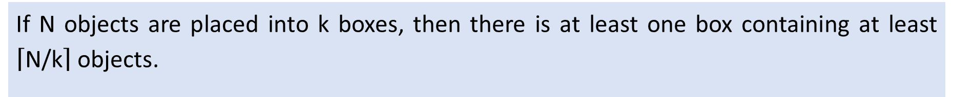
The Generalized Pigeonhole Principle
Theorem
If N objects are placed into k boxes, then there is at least one box containing at least $\left\lceil \text{N}\text{/}\text{k}\right\rceil$ objects.

Slide 20
The Generalized Pigeonhole Principle
Example
Among 100 people there are at least 100/12=9 who were born in the same month.
What is the minimum number of students required in a discrete mathematics class to be sure that at least six will receive the same grade, if there are five possible grades, A, B, C, D, and F?
Solution: The minimum number of students needed to ensure that at least six students receive the same grade is the smallest integer N such thatN/5=6. The smallest such integer is N=5·5+1=26. If you have only 25 students, it is possible for there to be five who have received each grade so that no six students have received the same grade. Thus, 26 is the minimum number of students needed to ensure that at least six students will receive the same grade.

Slide 21
The Generalized Pigeonhole Principle
Example
What is the minimum number of students required in a discrete mathematics class to be sure that at least six will receive the same grade, if there are five possible grades, A, B, C, D, and F?
Solution: The minimum number of students needed to ensure that at least six students receive the same grade is the smallest integer N such that N/5=6. The smallest such integer is N=5·5+1=26. If you have only 25 students, it is possible for there to be five who have received each grade so that no six students have received the same grade. Thus, 26 is the minimum number of students needed to ensure that at least six students will receive the same grade.

Slide 22
Any Questions?

